Slide 1

Exploring Distribution Strategy the Coronavirus Impact
Final Presentation
Andrew McCurdy, Rachael Burris, Samantha Patil, Sambhav Jain

Slide 2







AGENDA
Background
Problem
Extract, Transform, Load (ETL)
Data Processing
Database Design & Usage
Analysis
Data Visualization
Recommendations

Slide 3

CORONAVIRUS PANDEMIC
Background
Problem
ETL
Data Processing
DB Design & Usage
Analysis
Data Viz
Conclusion
•Nearly a year ago, the coronavirus-19 pandemic began sweeping the globe
•Every community has been impacted by the virus, resulting in millions of lost lives and an alarming number of business, threatening social and economic stability
•There has been an international push for treatments and vaccines to combat the pandemic with an unprecedented amount of turnaround time.
•With the current scalability of pending vaccine production, a multi tiered approach must be used for distributing the supply.
• Scientists, Pharmaceutical Executives, Government Officials and the general population alike have interest in how to better understand the state of the US and what aspects should be considered in tiering system.

Slide 4
EFFICIENT DISTRIBUTION OF VACCINE
Background
Problem
ETL
Data Processing
DB Design & Usage
Analysis
Data Viz
Conclusion
Impact by Demographic
What would efficient distribution look like?
How can we better understand the status of each state?
Access to Research Institutions
Hospital Capacities
Notes:
Background
Problem
Extract, Transform, Load (ETL)
Data Processing
Database Design & Usage
Analysis
Data Visualization
Recommendations

Slide 5


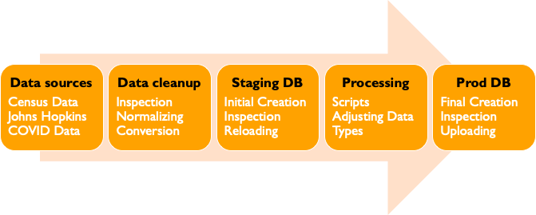




EXTRACT, TRANSFORM, LOAD
Background
Problem
ETL
Data Processing
DB Design & Usage
Analysis
Data Viz
Conclusion
Notes:
Sambhav
•Data sources
•Census Data
Johns Hopkins COVID Data
•Data cleanup
•Inspection
Normalizing
Conversion
•Staging DB
•Initial Creation
Inspection
Reloading
•Processing
•Scripts
Adjusting Data Types
•Prod DB
•Final Creation
Inspection
Uploading

Slide 6
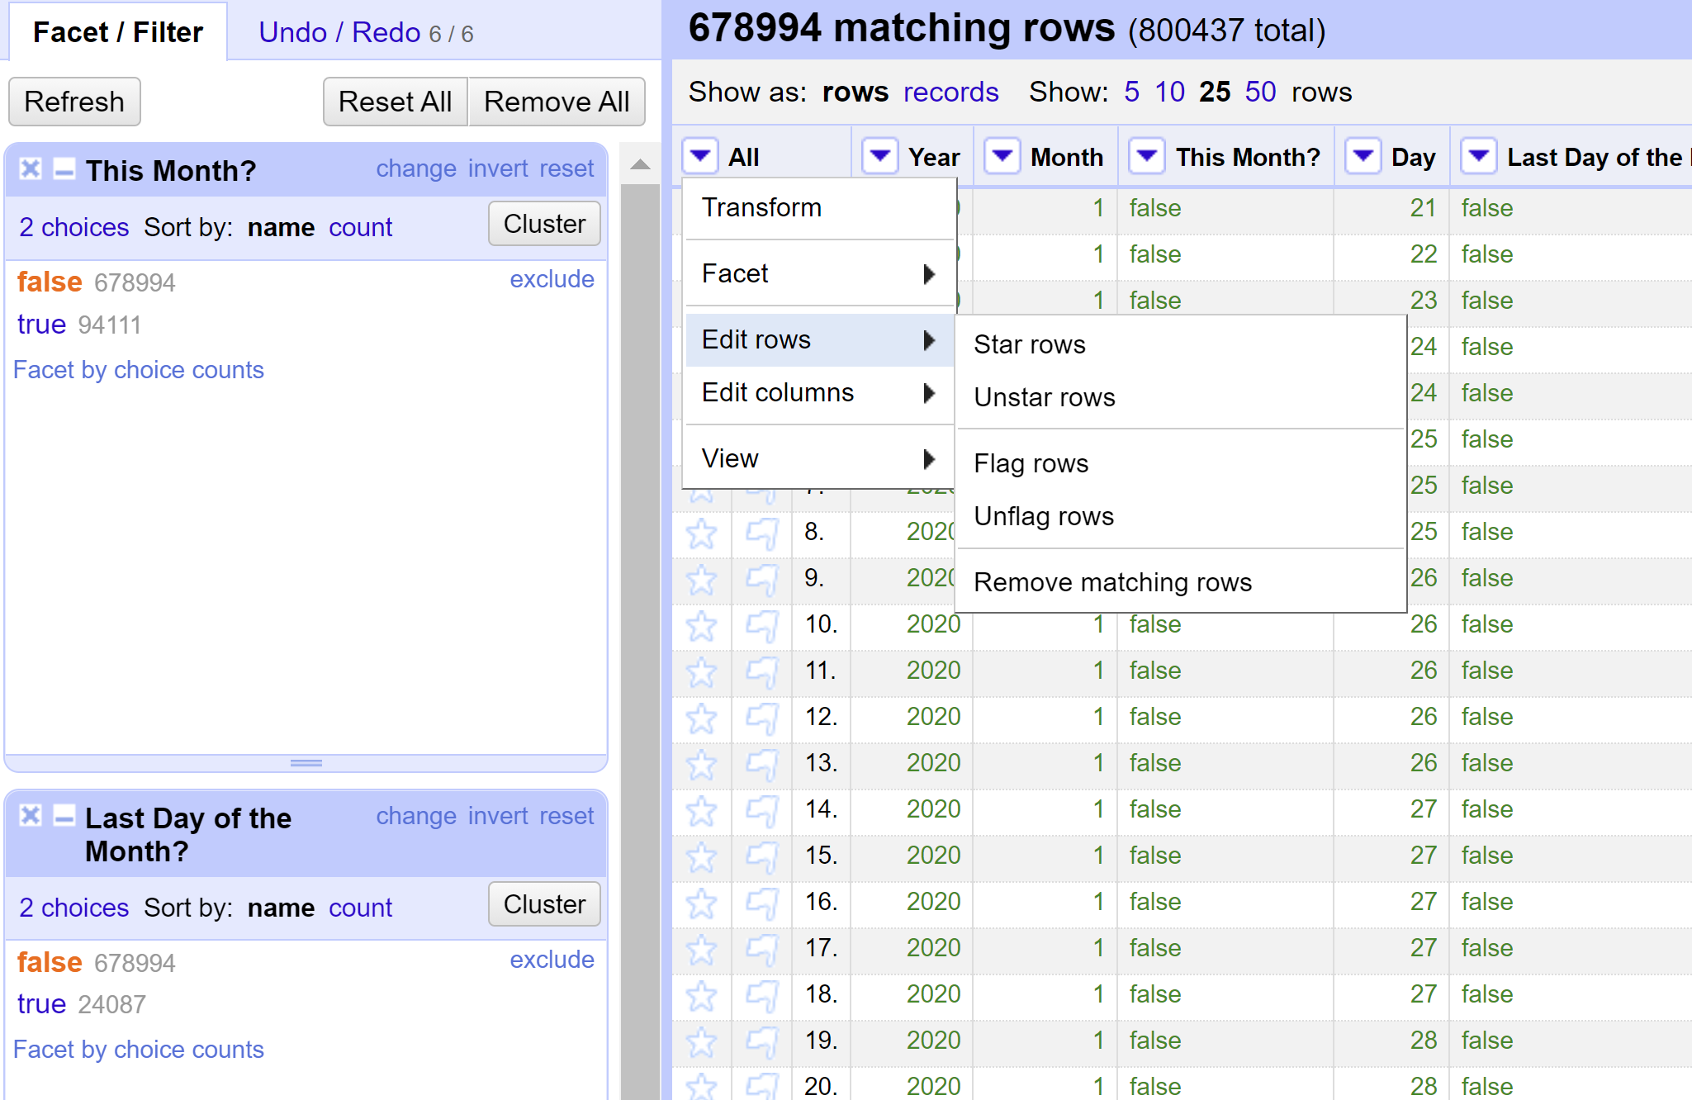

OPEN REFINE
Background
Problem
ETL
Data Processing
DB Design & Usage
Analysis
Data Viz
Conclusion
Critical to…
Dimensionality Reduction
800k rows to ~3k
40+ columns to 20
Normalization
column/row transformations
splitting multivalued cells
General Tidying
Clustering
Fill Down
Notes:
Rachael
Background
Problem
Extract, Transform, Load (ETL)
Data Processing
Database Design & Usage
Analysis
Data Visualization
Recommendations

Slide 7

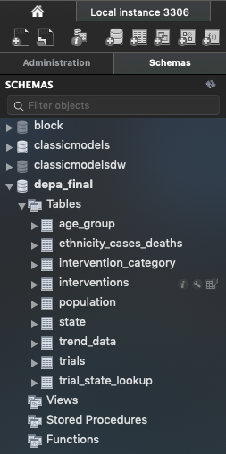
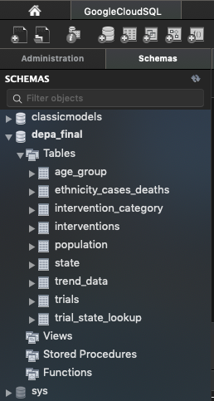
DATABASE CREATION
Background
Problem
ETL
Data Processing
DB Design & Usage
Analysis
Data Viz
Conclusion
Imported clean .CSV file’s from OpenRefine via Table Data Import Wizard in MySQL Workbench
Database Migration Wizard to migrate the data from local machine to shared Cloud
Source: Local Instance 3306
Destination: GoogleCloudSQL
Notes:
Background
Problem
Extract, Transform, Load (ETL)
Data Processing
Database Design & Usage
Analysis
Data Visualization
Recommendations

Slide 8
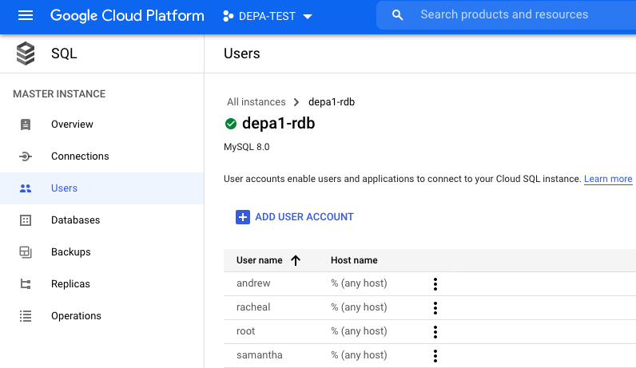

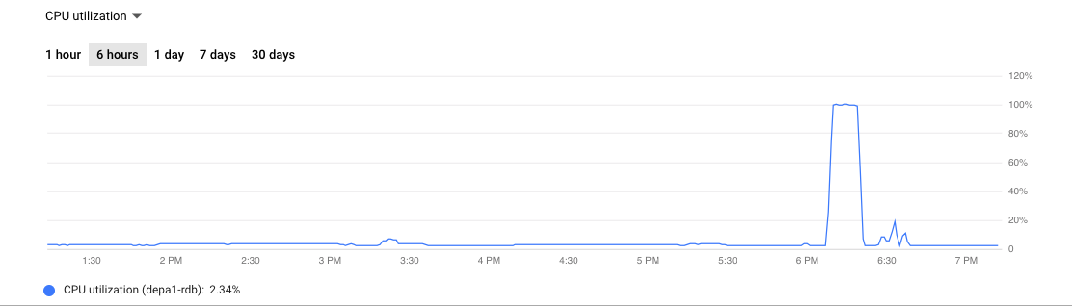
GOOGLE CLOUD
Background
Problem
ETL
Data Processing
DB Design & Usage
Analysis
Data Viz
Conclusion
Google Cloud Platform leveraged for our data warehousing needs
Scalability, Flexibility, Ease of use, Remote teammates
Initial: 1 VCPU, 3.75 GB Storage
Final: 2 VCPU, 7.5 GB Storage
Added multiple users and multiple IP addresses to allow teammates access
Migrated local DB (depa_final) to the Google Cloud Project
Verified teammates had access and were able to hit DB simultaneously
Notes:
Background
Problem
Extract, Transform, Load (ETL)
Data Processing
Database Design & Usage
Analysis
Data Visualization
Recommendations

Slide 9
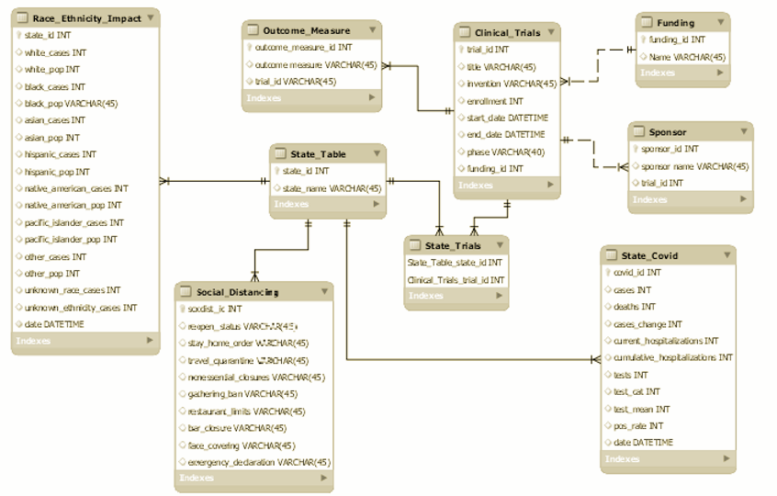
EER Model

Slide 10
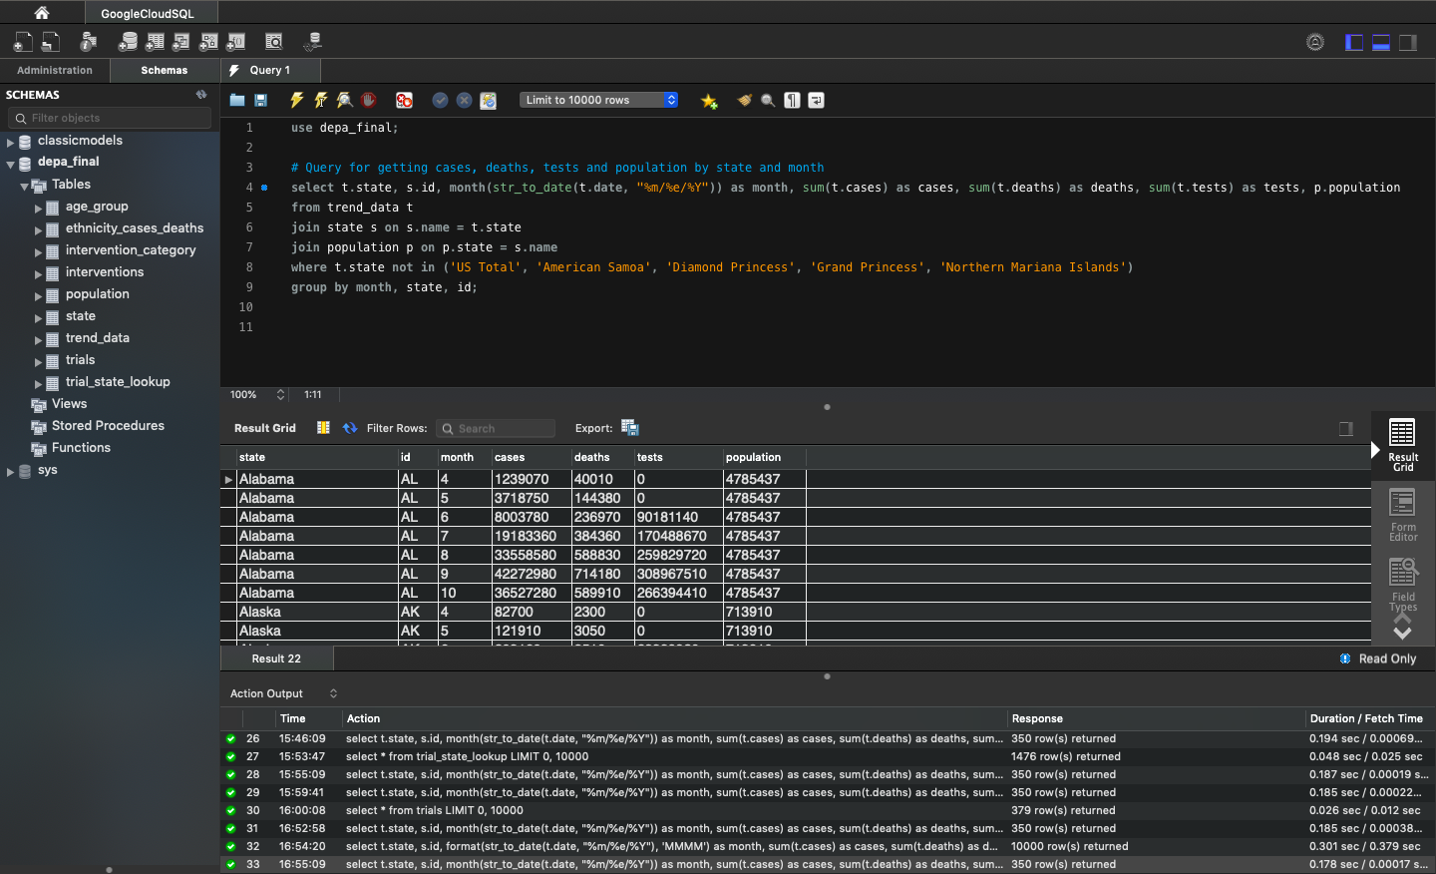
SQL QUERIES (available here)
Background
Problem
ETL
Data Processing
DB Design & Usage
Analysis
Data Viz
Conclusion
Identified key questions we wanted to answer
Wrote queries to give us data to answer said questions
Evaluated data queries gave us
Reworked questions and queries based on what the data looked like
Notes:
Background
Problem
Extract, Transform, Load (ETL)
Data Processing
Database Design & Usage
Analysis
Data Visualization
Recommendations

Slide 11
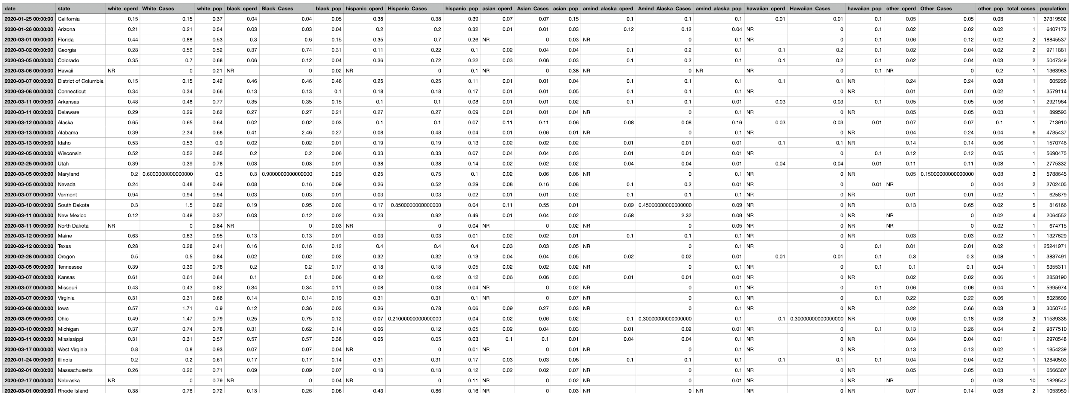
SQL ANALYSIS: Race and Ethnicity Data
Background
Problem
ETL
Data Processing
DB Design & Usage
Analysis
Data Viz
Conclusion
SELECT
s.date,
ecd.state,
ecd.white_cperd,
ecd.white_cperd*s.cases AS White_Cases,
ecd.white_pop,
ecd.black_cperd,
ecd.black_cperd*s.cases AS Black_Cases,
ecd.black_pop,
ecd.hispanic_cperd,
ecd.hispanic_cperd*s.cases AS Hispanic_Cases,
ecd.hispanic_pop,
ecd.asian_cperd,
ecd.asian_cperd*s.cases AS Asian_Cases,
ecd.asian_pop,
ecd.amind_alaska_cperd,
ecd.amind_alaska_cperd*s.cases AS Amind_Alaska_Cases,
ecd.amind_alaska_pop,
ecd.hawaiian_cperd,
ecd.hawaiian_cperd*s.cases AS Hawaiian_Cases,
ecd.hawaiian_pop,
ecd.other_cperd,
ecd.other_cperd*s.cases AS Other_Cases,
ecd.other_pop,
s.cases as total_cases,
p.population
FROM
us_states AS s
INNER JOIN
ethnicity_cases_deaths ecd ON s.state = ecd.state
JOIN
population p ON p.state = s.state
WHERE ecd.category = 'Cases'
GROUP BY ecd.state;
QUERY
RESULTS
Notes:
Background
Problem
Extract, Transform, Load (ETL)
Data Processing
Database Design & Usage
Analysis
Data Visualization
Recommendations

Slide 12
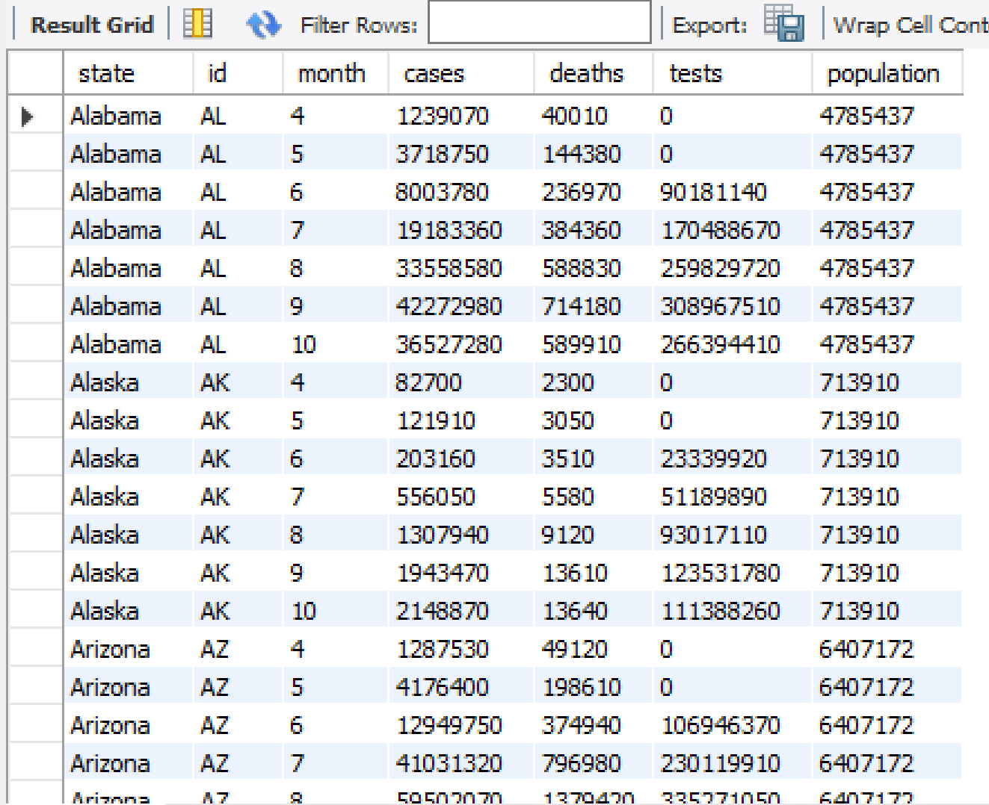
SQL ANALYSIS: Race and Ethnicity Data
Background
Problem
ETL
Data Processing
DB Design & Usage
Analysis
Data Viz
Conclusion
QUERY
RESULTS
select
t.state,
s.id,
month(str_to_date(t.date, "%m/%e/%Y")) as month,
sum(t.cases) as cases, sum(t.deaths) as deaths,
sum(t.tests) as tests,
p.population
from
trend_data t
join
state s on s.name = t.state
join
population p on p.state = s.name
where t.state not in ('US Total', 'American Samoa', 'Diamond Princess', 'Grand Princess', 'Northern Mariana Islands’)
group by month, state, id;
Notes:
Background
Problem
Extract, Transform, Load (ETL)
Data Processing
Database Design & Usage
Analysis
Data Visualization
Recommendations

Slide 13
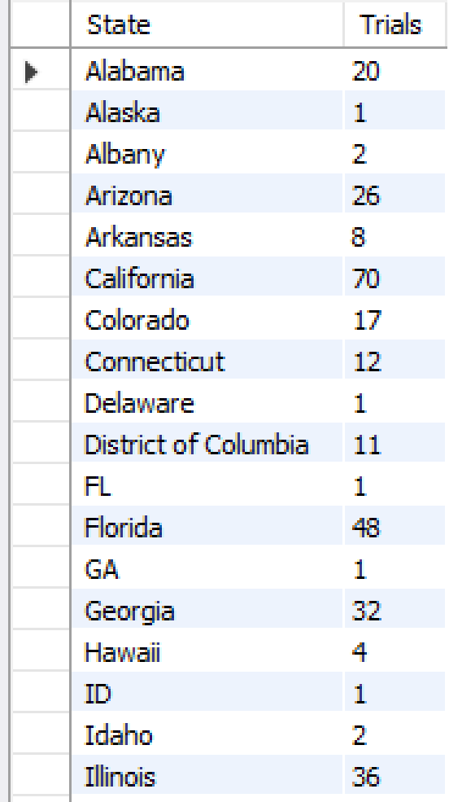
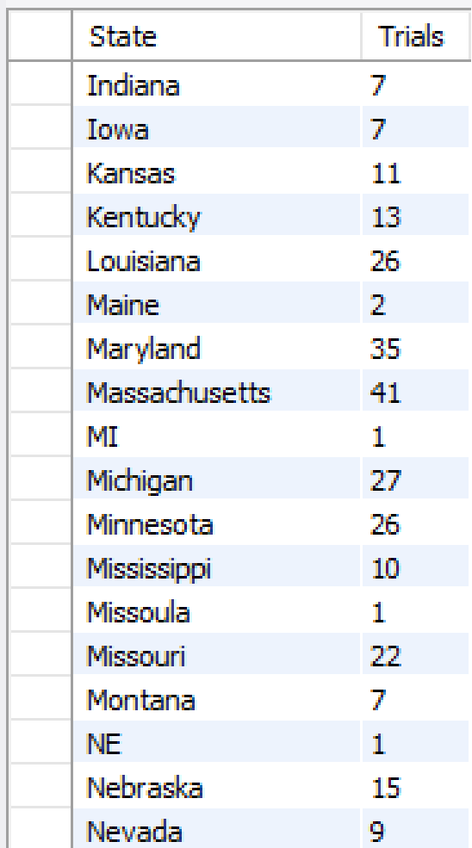
SQL ANALYSIS: COVID intventional studies per state
Background
Problem
ETL
Data Processing
DB Design & Usage
Analysis
Data Viz
Conclusion
QUERY
RESULTS
SELECT
a.state as State,
COUNT(DISTINCT(a.trial_id)) as Trials
FROM
trial_state_lookup a
JOIN
trials b ON a.trial_id = b.trial_id
WHERE b.intervention_category_id = 1001
GROUP BY a.state;
Notes:
Background
Problem
Extract, Transform, Load (ETL)
Data Processing
Database Design & Usage
Analysis
Data Visualization
Recommendations

Slide 14
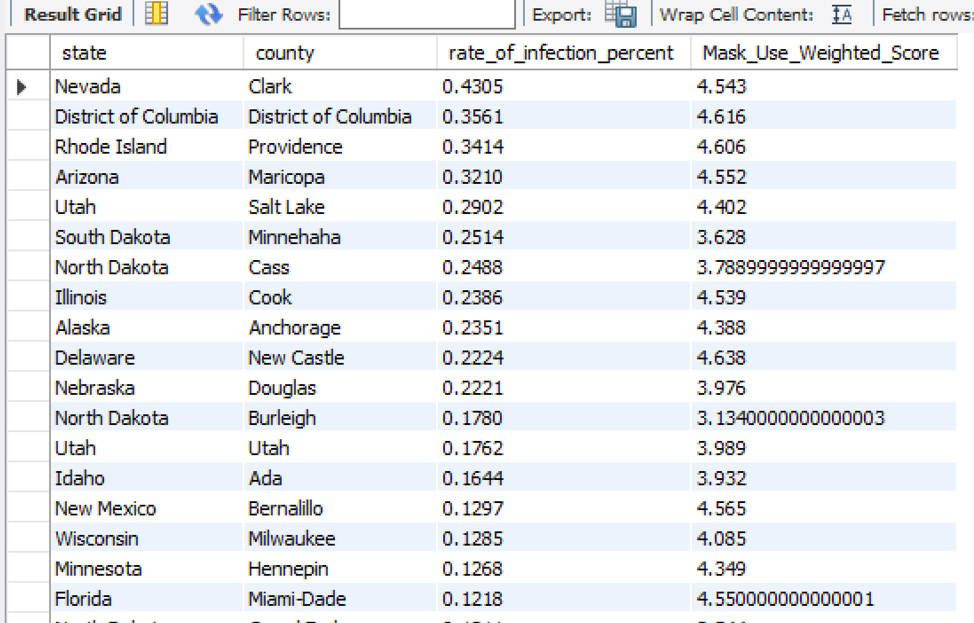
SQL ANALYSIS: Mask Usage and Infection Rate
Background
Problem
ETL
Data Processing
DB Design & Usage
Analysis
Data Viz
Conclusion
QUERY
RESULTS
SELECT
a.state,
a.county,
((a.cases / b.population)*10) as
rate_of_infection_percent,
((c.NEVER*1) + ( c.RARELY* 2) +
(c.SOMETIMES*3) + ( c.FREQUENTLY*4) +
(c.ALWAYS*5)) as Mask_Use_Weighted_Score #likert weighted scale formula
From
mask_use_by_county c
JOIN
recent_county_counts a ON c.COUNTYFP=a.fips
JOIN
population b on a.state = b.state
GROUP BY a.fips
ORDER BY rate_of_infection_percent DESC;
Notes:
Background
Problem
Extract, Transform, Load (ETL)
Data Processing
Database Design & Usage
Analysis
Data Visualization
Recommendations

Slide 15
SQL ANALYSIS: Tableau Preparation Queries
Background
Problem
ETL
Data Processing
DB Design & Usage
Analysis
Data Viz
Conclusion
QUERY
RESULTS
CREATE TABLE `us_counties_fips_1` (
`date` datetime DEFAULT NULL,
`county` text,
`state` text,
`fips` text,
`cases` int(11) DEFAULT NULL,
`deaths` int(11) DEFAULT NULL
) ;
insert into us_counties_fips_1
select * from us_counties;
set sql_safe_updates = 0;
update us_counties_fips_1
set fips = concat(0,fips)
where fips like '____';
insert into us_counties_fips
select * from us_counties;
set sql_safe_updates = 0;
update us_counties_fips
set fips = concat(0,fips)
where fips like '____';
select * from us_counties_fips_1;
CREATE TABLE `mask_use_by_county_fips` (
`COUNTYFP` text,
`NEVER` double DEFAULT NULL,
`RARELY` double DEFAULT NULL,
`SOMETIMES` double DEFAULT NULL,
`FREQUENTLY` double DEFAULT NULL,
`ALWAYS` double DEFAULT NULL
) ;
insert into mask_use_by_county_fips
select * from mask_use_by_county;
set sql_safe_updates = 0;
update mask_use_by_county_fips
set countyfp = concat(0,countyfp)
where countyfp like '____';
select * from mask_use_by_county_fips;
Notes:
Background
Problem
Extract, Transform, Load (ETL)
Data Processing
Database Design & Usage
Analysis
Data Visualization
Recommendations

Slide 16


KEY TAKEAWAYS FROM THE TABLEAU VISUALIZATION
Background
Problem
ETL
Data Processing
DB Design & Usage
Analysis
Data Viz
Conclusion
California, Florida and Texas saw a record rise in COVID-19 cases and deaths: Fatalities rise after surge in cases after mid-July. Consequently, coronavirus deaths jump in Florida, Texas and California.
Mask use is related to Covid risk: Places that have experienced a lot of coronavirus, with a few exceptions, show higher-than-usual rates of masking.
Overall Mask use is high: Despite the state-level variations, based our the dataset that comes from a large number of interviews and surveys, the rates of self-reported mask use in the United States are high.
US Trial of Hydroxychloroquine In Covid-19 Kinetics: The greatest number of clinical trials were testing the hydroxychloroquine drug — an antimalarial drug — to treat people with COVID-19.
Race-Ethnicity: Black and Indigenous Americans continue to suffer a great loss of life, death toll has been the highest among white population.
Notes:
Samantha
Background
Problem
Extract, Transform, Load (ETL)
Data Processing
Database Design & Usage
Analysis
Data Visualization
Recommendations

Slide 17
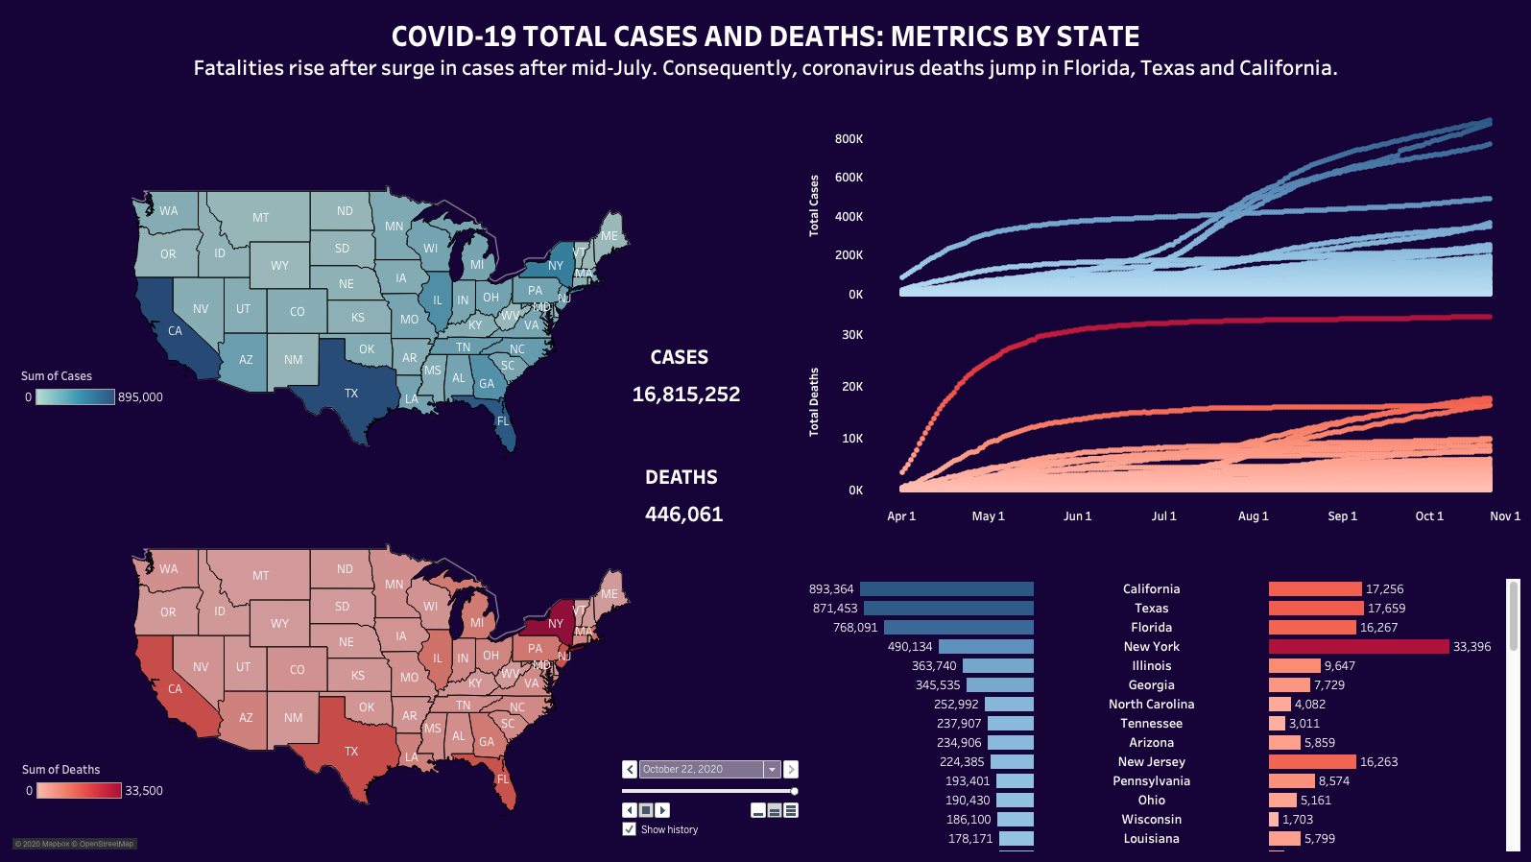
Notes:
Samantha

Slide 18
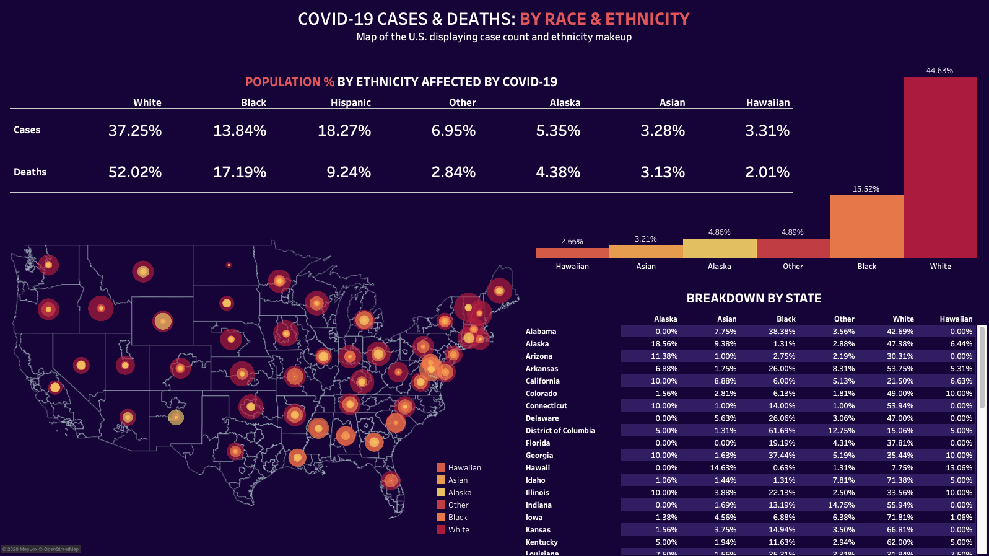
Notes:
Samantha
SELECT
s.date,
ecd.state,
ecd.white_cperd,
ecd.white_cperd*s.cases AS White_Cases,
ecd.white_pop,
ecd.black_cperd,
ecd.black_cperd*s.cases AS Black_Cases,
ecd.black_pop,
ecd.hispanic_cperd,
ecd.hispanic_cperd*s.cases AS Hispanic_Cases,
ecd.hispanic_pop,
ecd.asian_cperd,
ecd.asian_cperd*s.cases AS Asian_Cases,
ecd.asian_pop,
ecd.amind_alaska_cperd,
ecd.amind_alaska_cperd*s.cases AS Amind_Alaska_Cases,
ecd.amind_alaska_pop,
ecd.hawaiian_cperd,
ecd.hawaiian_cperd*s.cases AS Hawaiian_Cases,
ecd.hawaiian_pop,
ecd.other_cperd,
ecd.other_cperd*s.cases AS Other_Cases,
ecd.other_pop,
s.cases as total_cases,
p.population
FROM
us_states AS s
INNER JOIN
ethnicity_cases_deaths ecd ON s.state = ecd.state
JOIN
population p ON p.state = s.state
WHERE
ecd.category = 'Cases'
GROUP BY ecd.state;

Slide 19
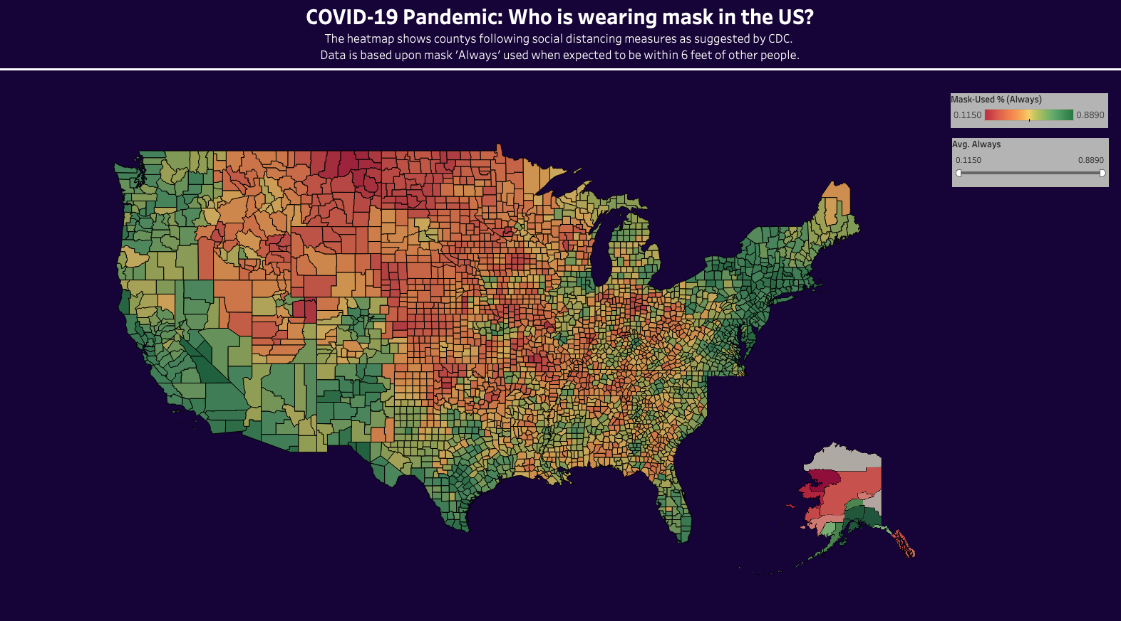
Notes:
Samantha

Slide 20
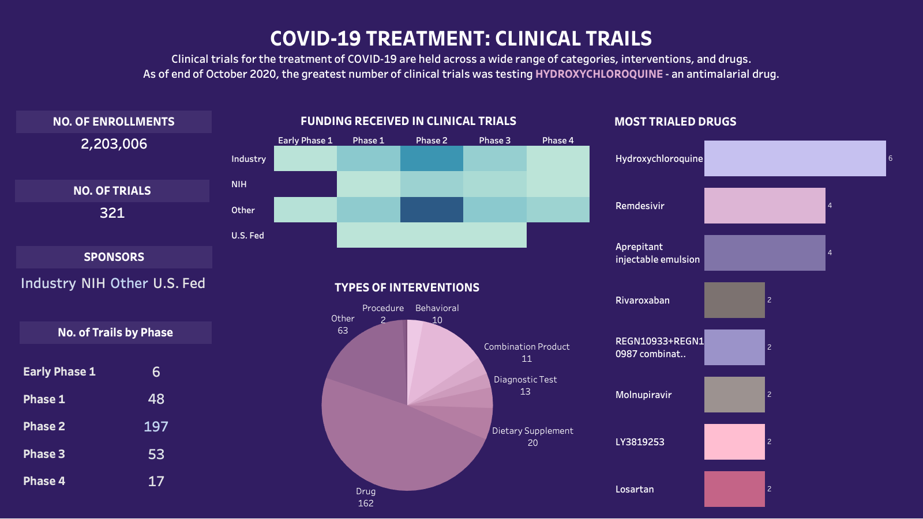
Notes:
Samantha

Slide 21
RECOMMENDATIONS
Background
Problem
ETL
Data Processing
DB Design & Usage
Analysis
Data Viz
Conclusion
Vaccine distribution should be prioritized in high density areas for easier distribution and areas with high concentrations of Covid Cases. States experiencing more recent surges like Florida, Texas and California should be at the top of this list.
Within these high density areas, prioritization should go to people with pre-existing conditions and the elderly.
Do NOT take Hydroxycloroquine
Notes:
Andrew
Background
Problem
Extract, Transform, Load (ETL)
Data Processing
Database Design & Usage
Analysis
Data Visualization
Recommendations

Slide 22
SUMMARY
Covid-19 remains the single greatest crisis facing the world today but the introduction of vaccines has the power to resolve it and save hundreds of thousands of lives in the process.
Each day that passes without a vaccine costs thousands of lives and billions of dollars to the global economy. A well thought out strategy is critical to maximizing the effect of the vaccine while also minimizing the distribution time and financial cost incurred by the virus.
Notes:
Andrew

Slide 23

THANK YOU
Final Presentation
Andrew McCurdy, Racheal Burris, Samantha Patil, Sambhav Jain

